Slide 1
Quantum Computing
Project
Prapti Setty
Isaac Walker
Eoin Dowling Patrick Jennings
David Phillips
JC Zhang
Daniel Cosgrove
Notes:
Isaac

Slide 2
Project Specification
The Quantum Development Kit:
Create a Simulation using the newly released Microsoft Quantum Development Kit with support from the mentors
Our Challenge:
Learn the concepts of Quantum Computing
Learn to use the Quantum Development kit
Learn Q#
Run Simple Programs
Create and run our own program
Notes:
Prapti

Slide 3

Quantum Computing
Quantum computing is computing using quantum-mechanical phenomena, such as superposition and entanglement. A quantum computer is a device that performs quantum computing
Notes:
Prapti

Slide 4
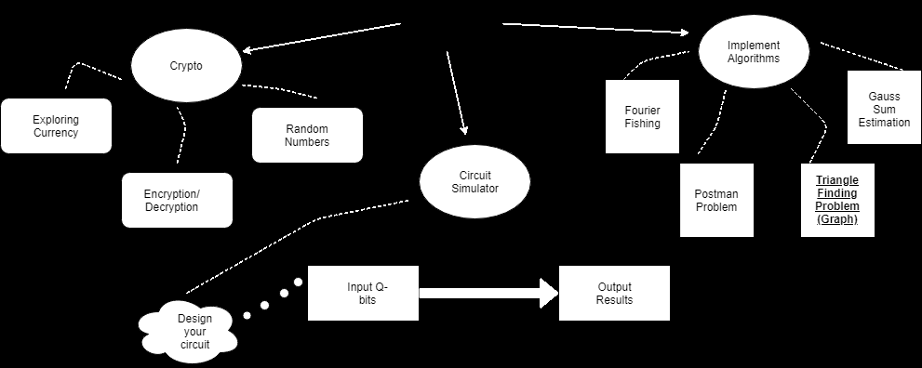
Our Approach to the Challenge
Brainstorming Ideas:
Quantum Computing
Notes:
Prapti

Slide 5
Our Approach to the Challenge
The Triangle Finding Problem:
The triangle-finding problem is the problem of determining whether a given graph contains a triangle (a clique of size 3). Classical algorithms depend on the speed of matrix multiplication, with the best known time complexity being O(v^2.4), where v is the number of vertices, however there is a quantum algorithm theorised to run with Õ(v^1.25)
Notes:
Patrick

Slide 6
Our Approach to the Challenge
A good problem to tackle?
Pros:
Familiarity - we all know a bit of graph theory (Discrete Mathematics)
Simplicity - Understanding the problem (classical algorithm) itself isn’t the hard part
Resources online to get us there
Not-So-Pros:
Still a complicated problem to solve (Quantum)
New Language - Limited Documentation
Difficult to measure how much more efficient the quantum algorithm is
Notes:
JC

Slide 7
Project Plan - Timeline
Week 1-3 : Learn concepts of Quantum Computing and brainstorm ideas
Week 4-6: Learn to use Development Kit (Q#)
Week 7: Implement traditional algorithm - Brute Force
Week 8 : Implement Smarter Traditional Algorithm - Trace
Week 9 - 11: Implement quantum algorithm
Week 12: Comparisons, Graphs & Reports
Notes:
JC

Slide 8
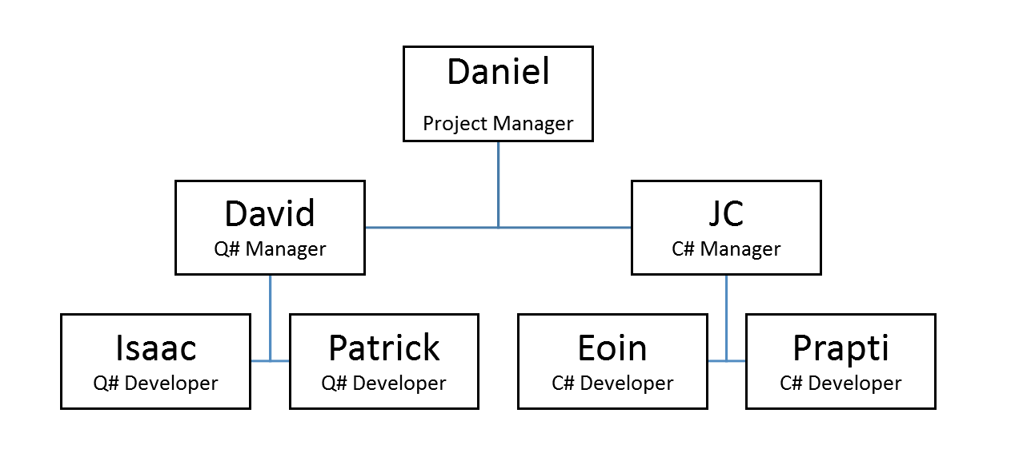
Project Plan - Work Distribution
Notes:
JC

Slide 9
Project Plan - Problem Breakdown & Functionality
Steps to the Quantum Algorithm:
Create array of all possible edges from adjacency matrix
Create an array of qubits, being log to the base 2 of the size of the array of edges, ceilinged, and with one extra which is the marked qubit that will contain the result
Create an oracle from the marked elements of the array. The oracle is a so called 'black box' which is essentially an unknown boolean function which returns one or zero
Notes:
Patrick

Slide 10
Run the oracle, followed by amplitude amplification for a predetermined number of steps
Check the marked qubit for a success or failure
Find the edge that the search found
If the marked qubit shows success, this is an edge. If successful, move to step 8, otherwise, repeat from step 2, or exit with failure if the max number of repeats has been reached
Notes:
Patrick

Slide 11
Similarly, find the array within the adjacency matrix that corresponds to one of the vertices, and run steps 2 to 6
If a success is found, this means that the vertex found makes an edge with the vertex we are checking
Check the second vertex of the found edge to check if an edge exists with the third vertex
If one does, a triangle is present, otherwise return to do steps 2 to 6 to find another vertex, or go back and find another edge if the max number of repeats has been reached
Notes:
Isaac

Slide 12
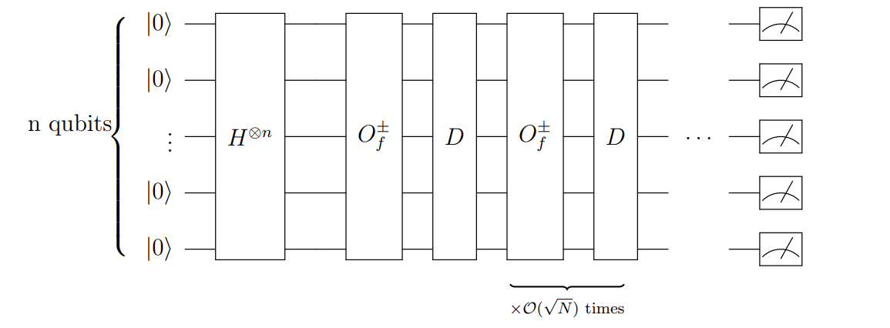
Project Plan - Problem Breakdown & Functionality
Quantum Circuit for Grover's algorithm
Notes:
Isaac

Slide 13
Our implementation’s Run Time
O( (((√(2^ceiling(log₂(VC2)) / E) - 1) * (Max(V,E) * 5))^2) *oracle calls))
P.s. - this is worst case!
Notes:
Patrick

Slide 14

Software Demo
Notes:
Prapti

Slide 15
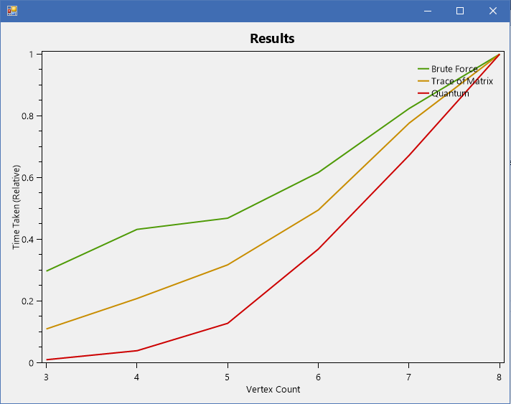
Algorithm comparison
Notes:
David

Slide 16

Project Experience -
Review & Possible Improvements
Did we complete the task?
We successfully implemented a quantum algorithm in Q#
We compared this algorithm to classical versions
What difficulties did we face?
Selecting the right task to tackle
Learning the Q# language
Implementing the Triangle Finding algorithm
Improvements:
Time taken to decide what algorithm to implement
Notes:
eoin

Slide 17
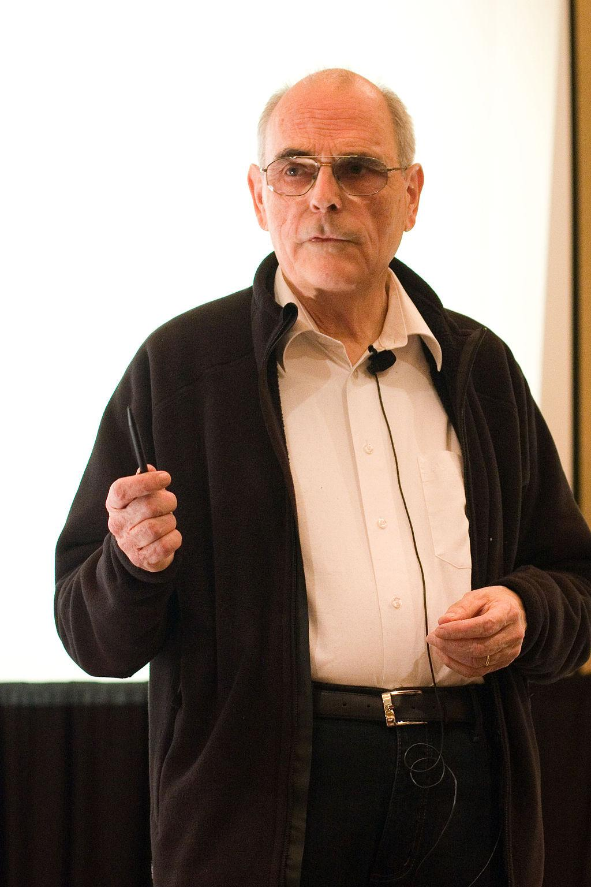
Refinements to Project
(Classical)
Strassen’s - Significantly reduces the time complexity down from O(N^Log(8)) to O(N^Log(7)). i.e. from O(N^3) down to approx. O(N^(2.801...))
Originally wanted a refinement of this algorithm, Coppersmith-Winograd, which has one of the best known time complexity for matrix multiplication [ O(N^2.3..) ]. (impractical!)
Volker Strassen
Knuth Prize and Cantor Medal Laurate
StrSStrasse
Notes:
This is a Fast Matrix Multiplication Algorithm developed by Volker Strassen.
and this took off a great deal of time which could have in hindsight been used more resourcefully.
Our approach to this problem from a classical perspective

Slide 18
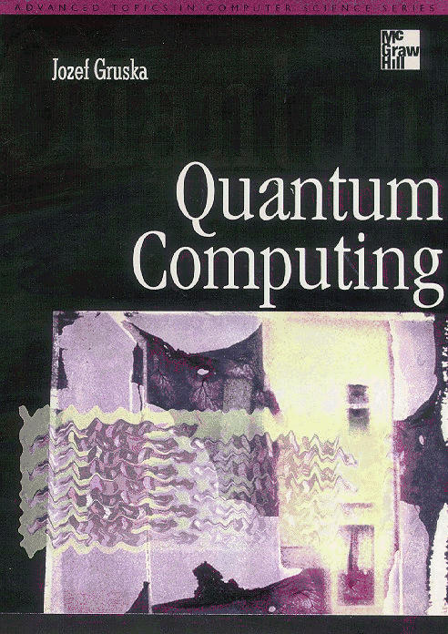
Refinements to Project (Quantum)
G-BBHT search algorithm:
Refinement of Grover’s Search Algorithm
Would allow us to search for more than one Vertex at the one time
Perhaps more appropriate for the Triangle Search Problem

Slide 19

Notes:
Daniel

